Slide 1
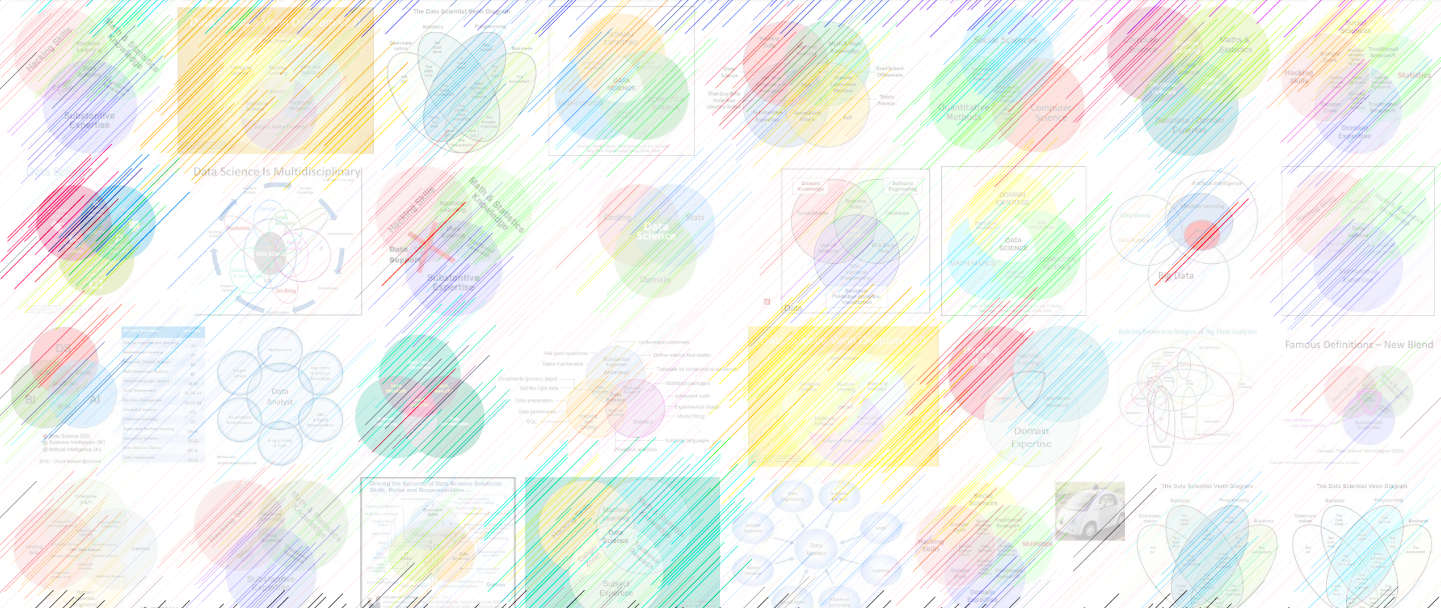

DATA221 Intro Machine Learning 04 Gaussians
William Trimble
Winter 2023

Slide 2
Plan
Least Squares Adjustment (demo)
Definitions
Anatomy of the Gaussian distribution
Fitting one-dimensional Gaussian mixture distribution

Slide 3
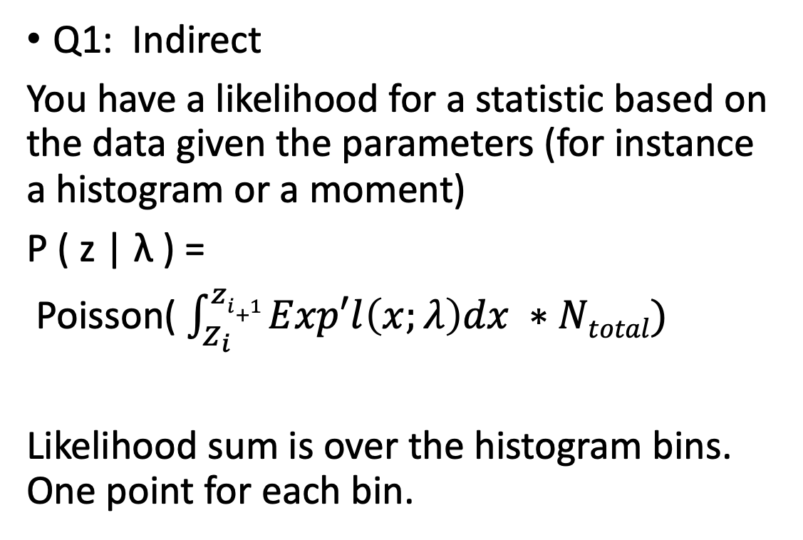
Problems 1 and 2 on homework present different types of attacks on inference:
Q2: Direct
You have a likelihood for the data given the parameters
P ( x | λ )
P ( childHeight |𝜇, 𝜎)
Likelihood sum is over the data points; one term for each observation
Q1: Indirect
You have a likelihood for a statistic based on the data given the parameters (for instance a histogram or a moment)
P ( z | λ ) =
Poisson( $\int_{Z_{i}}^{zi+1}{Exp′l\left(x;λ\right)dx ∗Ntotal)}$
Likelihood sum is over the histogram bins. One point for each bin.

Slide 4
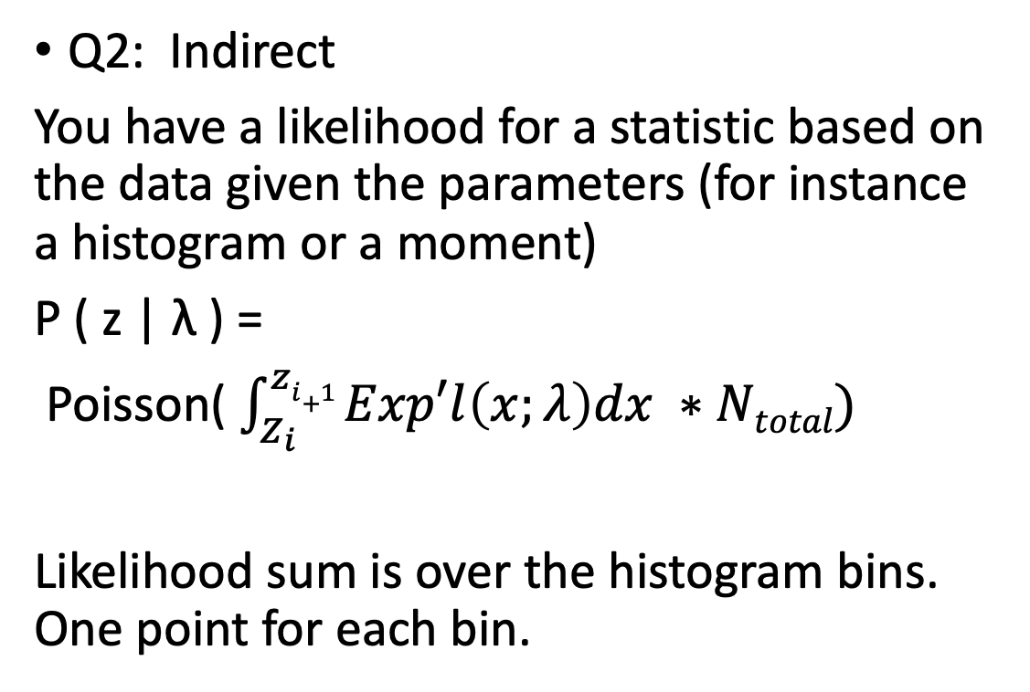
Problems 1 and 2 on homework present different types of attacks on inference:
Q2: Direct
You have a likelihood for the data given the parameters
P ( x | λ )
P ( childHeight |𝜇, 𝜎)
Likelihood sum is over the data points; one term for each observation
Q2: Indirect
You have a likelihood for a statistic based on the data given the parameters (for instance a histogram or a moment)
P ( z | λ ) =
Poisson( $\int_{Z_{i}}^{zi+1}{Exp′l\left(x;λ\right)dx ∗Ntotal)}$
Likelihood sum is over the histogram bins. One point for each bin.
Do you have probability for the values of the data?

Slide 5
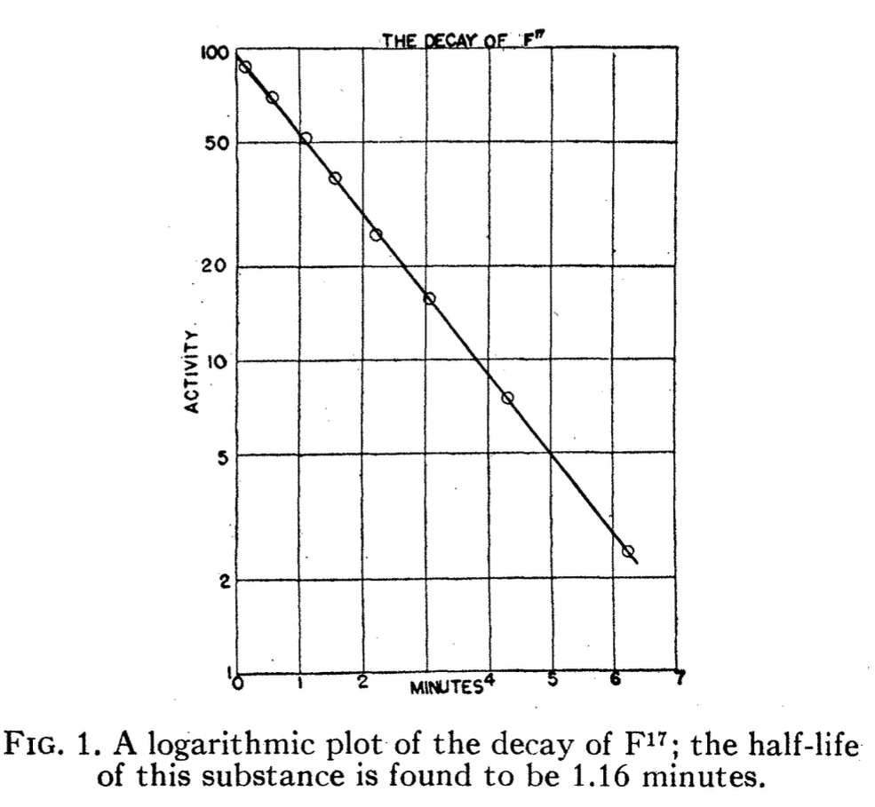
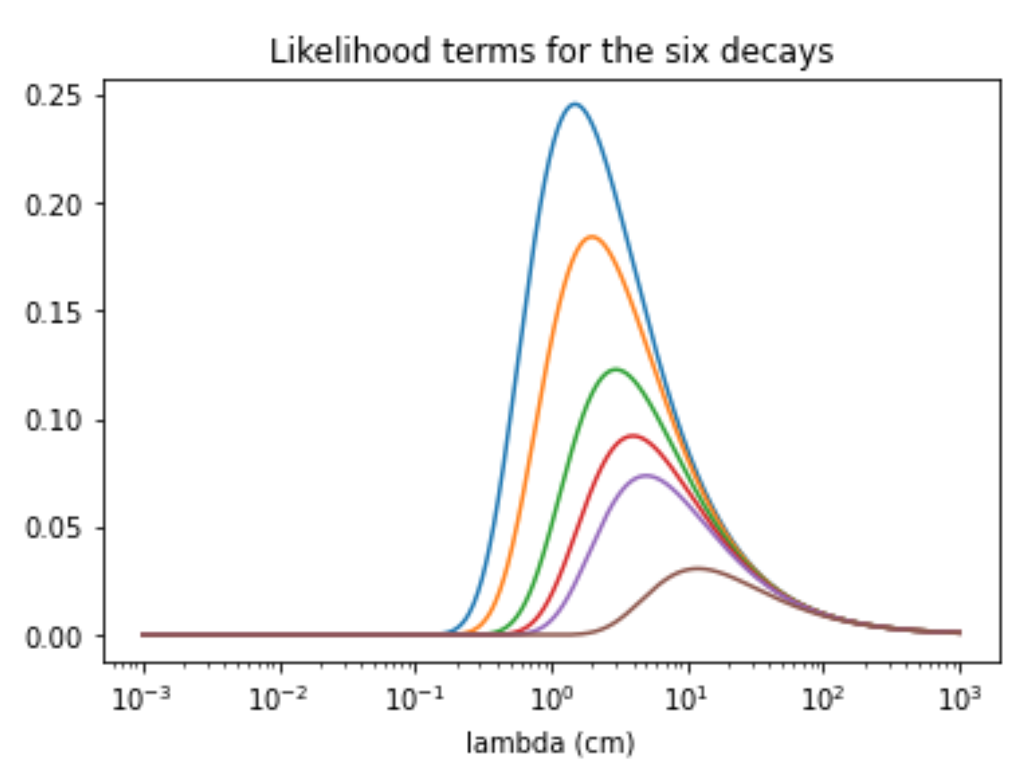
Newsom, Phys Rev 48 790

Slide 6
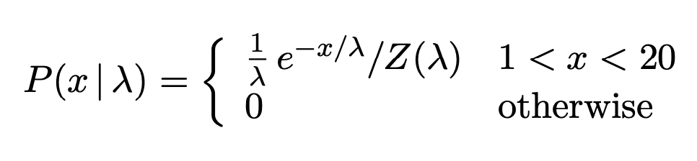
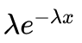
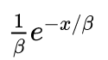
The simplest case of parameterization ambiguity: distribution of a single parameter
MacKay Ch3:
Wikipedia “Exponential distribution”
decay rate
Wikipedia “Alternate parameterization”
decay length /
decay time

Slide 7
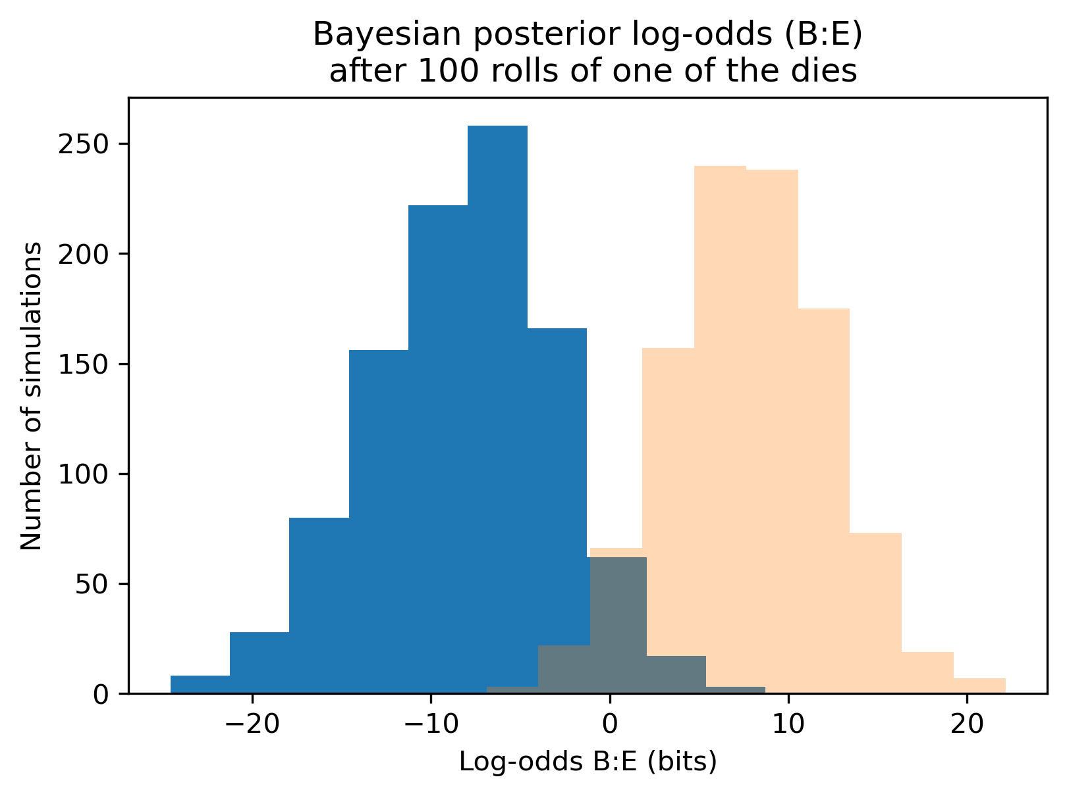
Dice problem

Slide 8
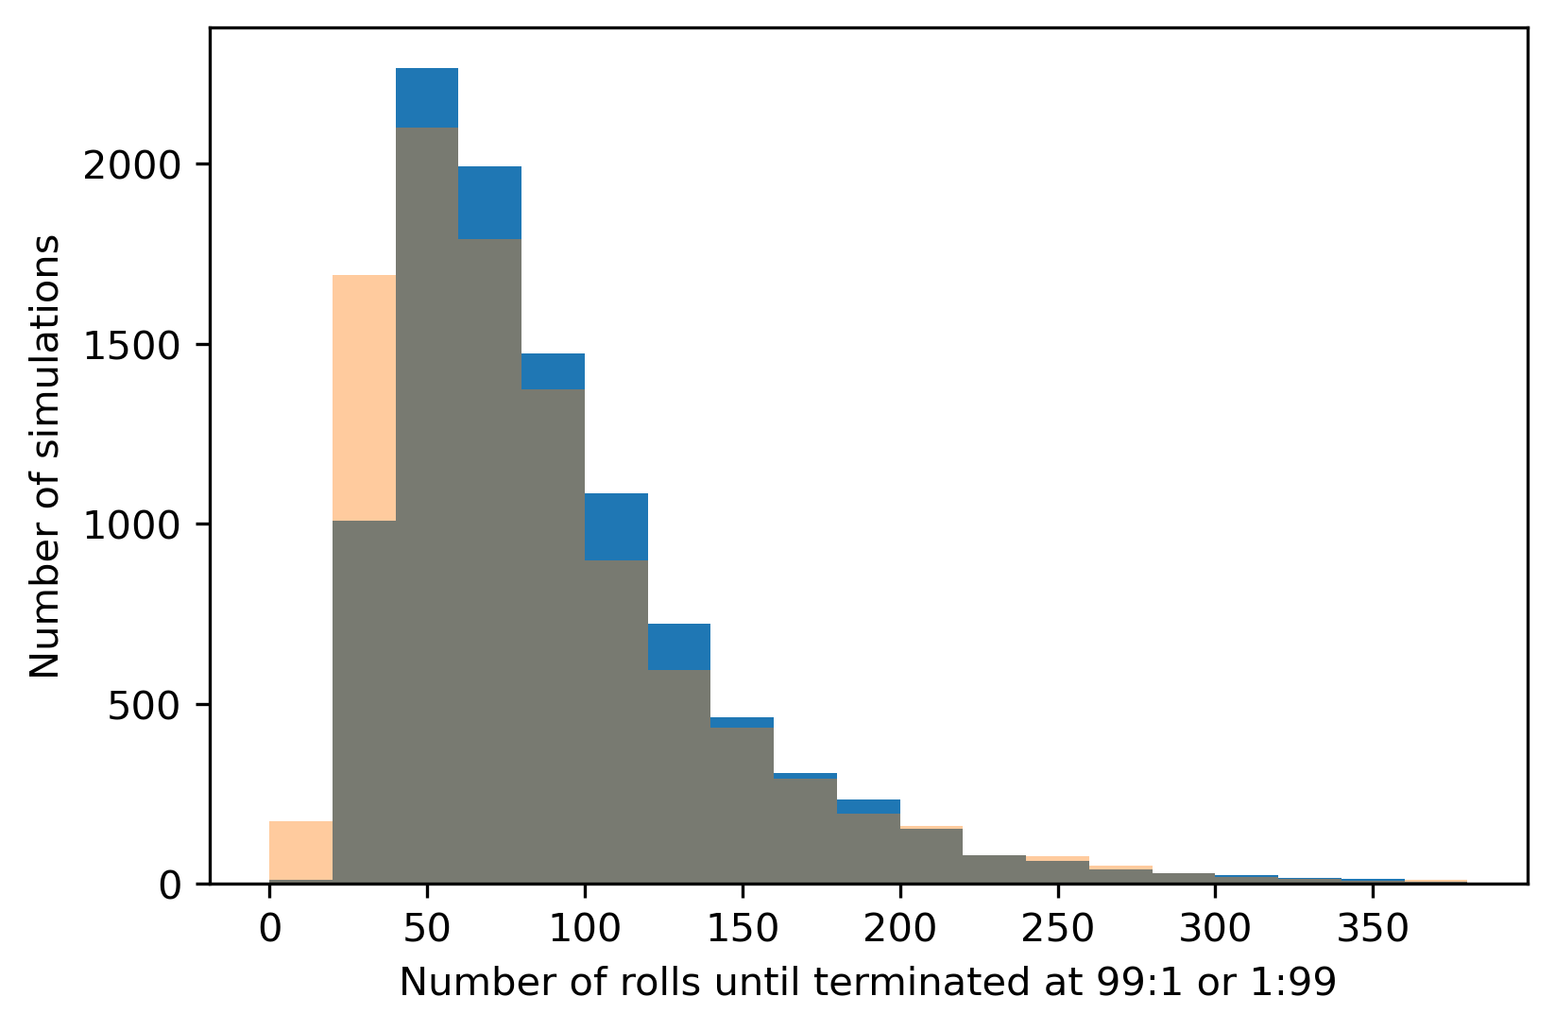
Dice problem

Slide 9
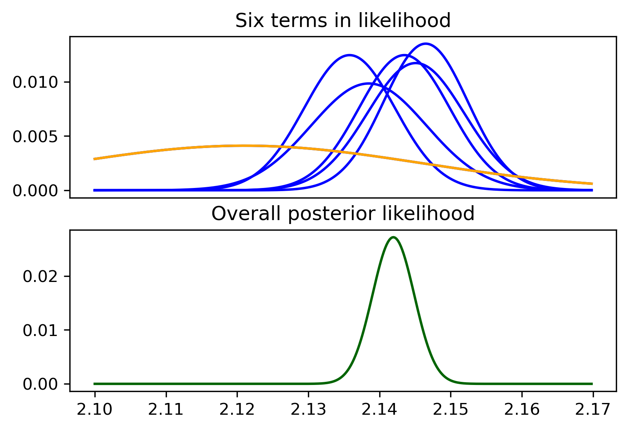
Least-squares adjustment with normal posteriors
This is the simplest Bayesian inference problem I can think of with a one-dimensional, continuous variable; the probability density at every stage is a well-behaved normal distribution.
The log-likelihoods are parabolas.
Caution: this weighted-average approach takes the standard deviations as known with certainty.
Posterior(x) = P₁(x) P₂(x) P₃(x) P₄(x) P₅(x) Prior(x)
LEASTSQADJUST.ipynb

Slide 10
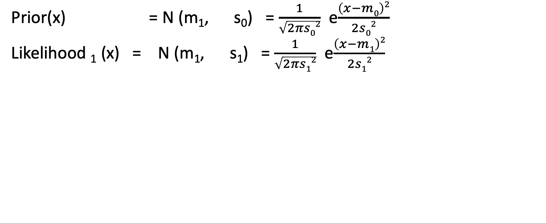
Least-squares adjustment
Prior(x) = N (m₁, s₀) = $\frac{1}{\sqrt{2πs02}}$ e$\frac{\left(x−m0\right)2}{2s02}$
Likelihood ₁ (x) = N (m₁, s₁) = $\frac{1}{\sqrt{2πs12}}$ e$\frac{\left(x−m1\right)2}{2s12}$
In one dimension, imagine I have a variable x.
I want the best number I can get for P ( x| DATA ) (the posterior)
but all I have are a basket full of p( DATAi | x ). (the likelihoods)
Bayes’ rule to the rescue!
P( x | DATA) = P(x) P(DATA | x) / p(DATA)

Slide 11
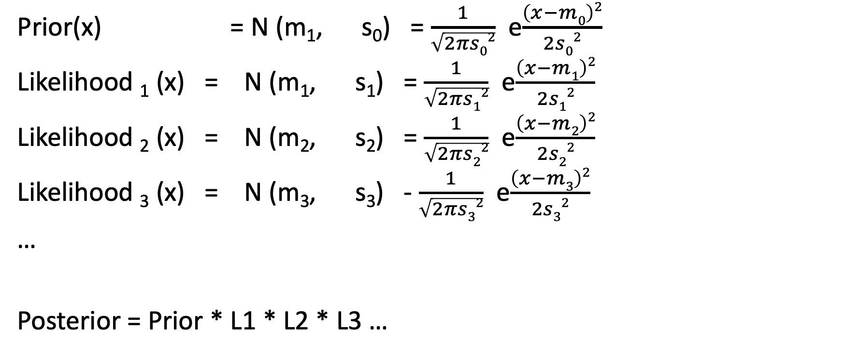
Least-squares adjustment
Prior(x) = N (m₁, s₀) = $\frac{1}{\sqrt{2πs02}}$ e$\frac{\left(x−m0\right)2}{2s02}$
Likelihood ₁ (x) = N (m₁, s₁) = $\frac{1}{\sqrt{2πs12}}$ e$\frac{\left(x−m1\right)2}{2s12}$
Likelihood ₂ (x) = N (m₂, s₂) = $\frac{1}{\sqrt{2πs22}}$ e$\frac{\left(x−m2\right)2}{2s22}$
Likelihood ₃ (x) = N (m₃, s₃) - $\frac{1}{\sqrt{2πs32}}$ e$\frac{\left(x−m3\right)2}{2s32}$
…
Posterior = Prior * L1 * L2 * L3 …

Slide 12
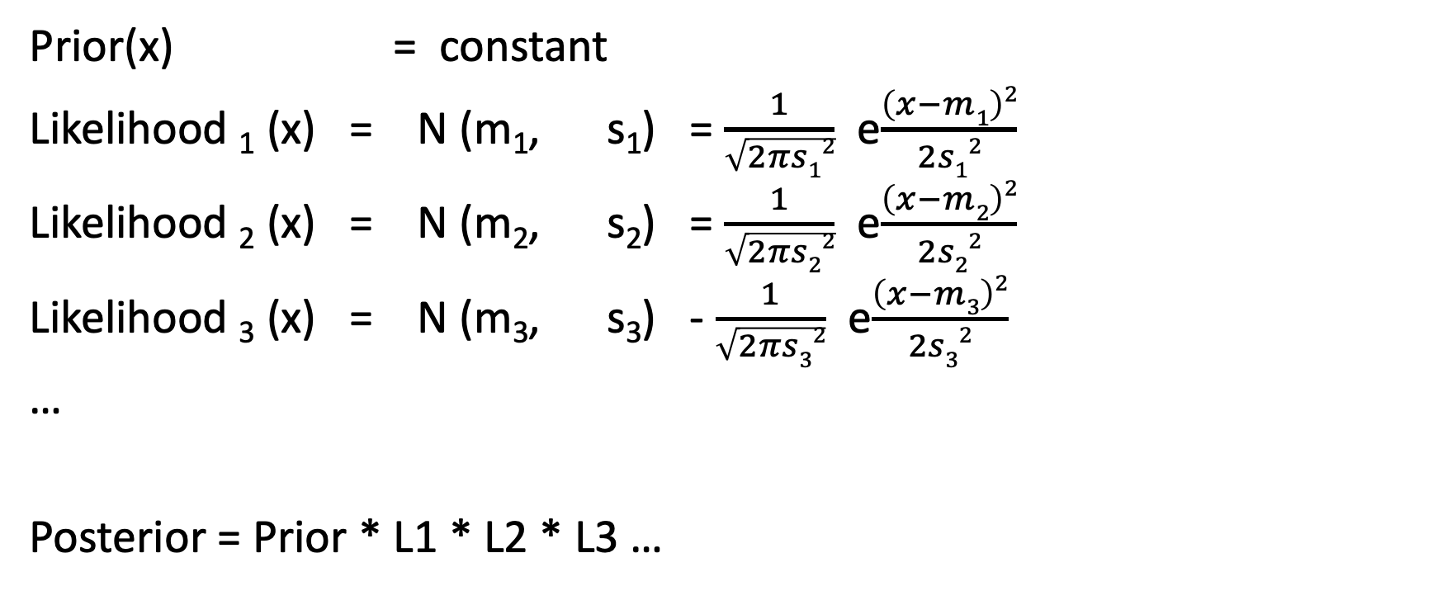
Take prior to be constant for now; take logs of all the likelihoods:
Prior(x) = constant
Likelihood ₁ (x) = N (m₁, s₁) = $\frac{1}{\sqrt{2πs12}}$ e$\frac{\left(x−m1\right)2}{2s12}$
Likelihood ₂ (x) = N (m₂, s₂) = $\frac{1}{\sqrt{2πs22}}$ e$\frac{\left(x−m2\right)2}{2s22}$
Likelihood ₃ (x) = N (m₃, s₃) - $\frac{1}{\sqrt{2πs32}}$ e$\frac{\left(x−m3\right)2}{2s32}$
…
Posterior = Prior * L1 * L2 * L3 …

Slide 13
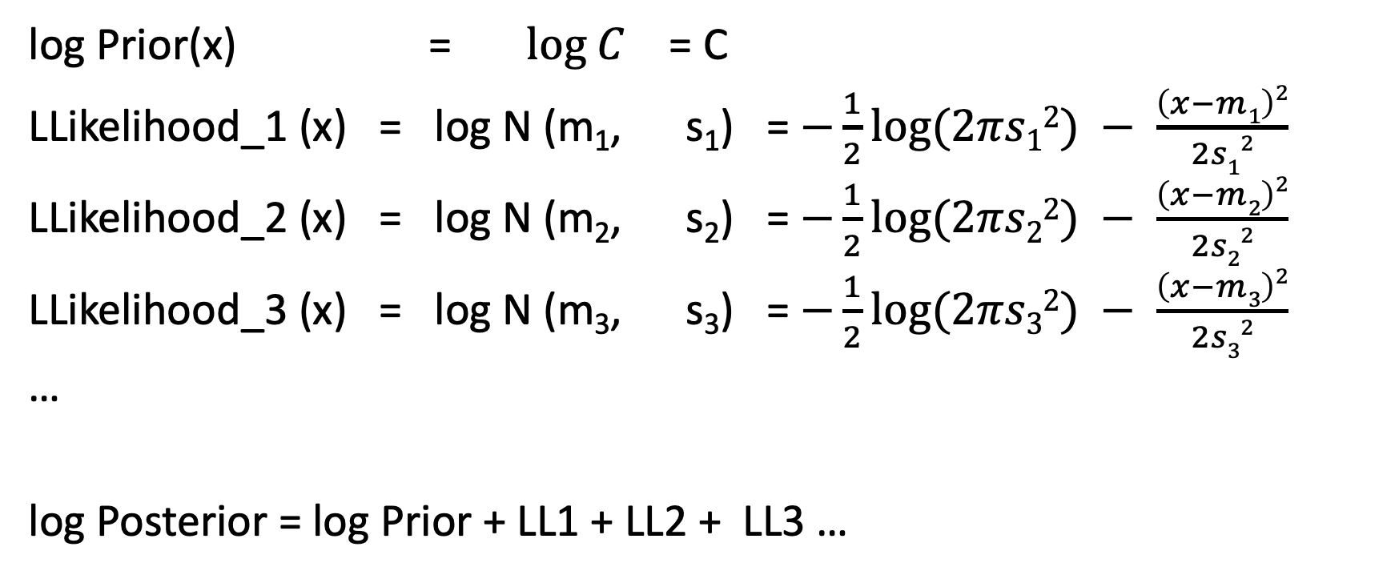
Least-squares adjustment
log Prior(x) = $log C$ = C
LLikelihood_1 (x) = log N (m₁, s₁) = $−\frac{1}{2}\log{(2πs12}) −$ $\frac{\left(x−m1\right)2}{2s12}$
LLikelihood_2 (x) = log N (m₂, s₂) = $−\frac{1}{2}\log{(2πs22}) −$ $\frac{\left(x−m2\right)2}{2s22}$
LLikelihood_3 (x) = log N (m₃, s₃) = $−\frac{1}{2}\log{(2πs32}) −$ $\frac{\left(x−m3\right)2}{2s32}$
…
log Posterior = log Prior + LL1 + LL2 + LL3 …

Slide 14
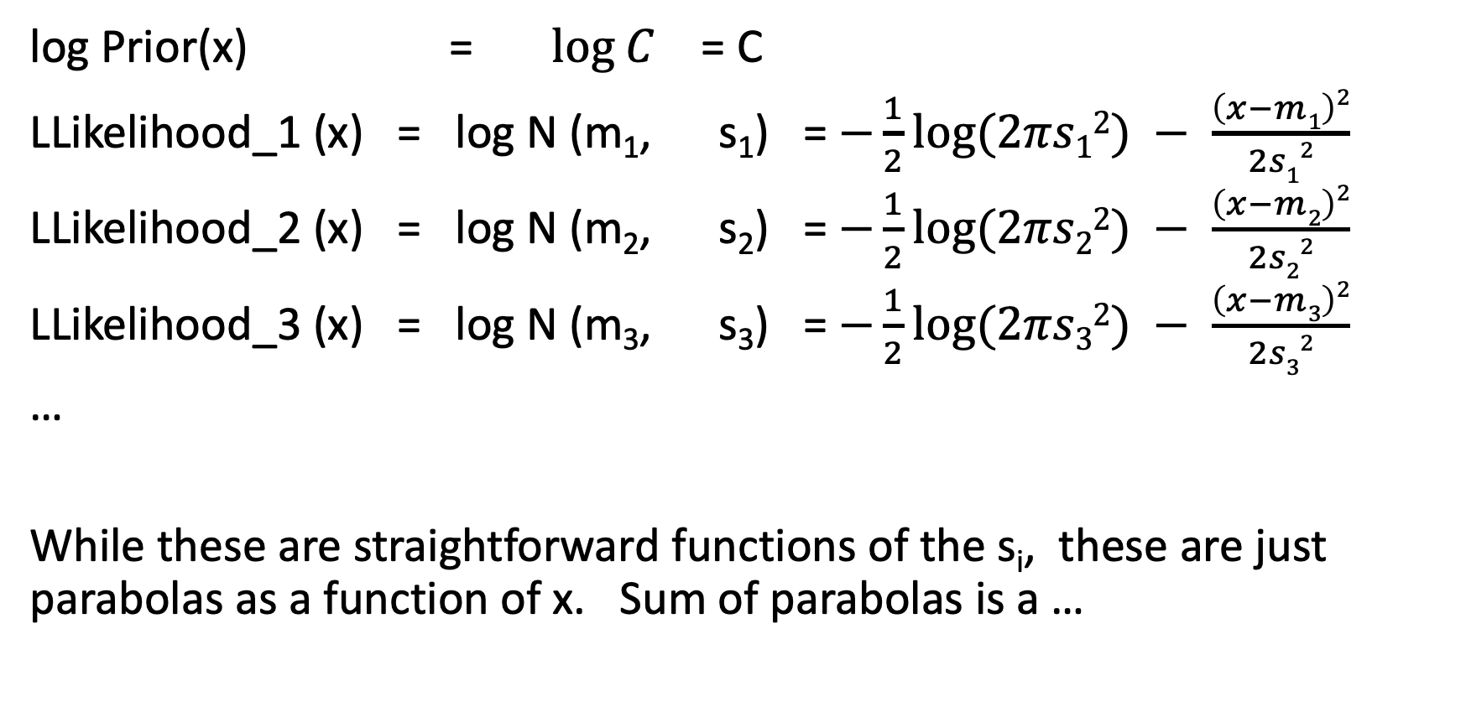
Least-squares adjustment
log Prior(x) = $log C$ = C
LLikelihood_1 (x) = log N (m₁, s₁) = $−\frac{1}{2}\log{(2πs12}) −$ $\frac{\left(x−m1\right)2}{2s12}$
LLikelihood_2 (x) = log N (m₂, s₂) = $−\frac{1}{2}\log{(2πs22}) −$ $\frac{\left(x−m2\right)2}{2s22}$
LLikelihood_3 (x) = log N (m₃, s₃) = $−\frac{1}{2}\log{(2πs32}) −$ $\frac{\left(x−m3\right)2}{2s32}$
…
While these are straightforward functions of the s_{i}, these are just parabolas as a function of x. Sum of parabolas is a …

Slide 15
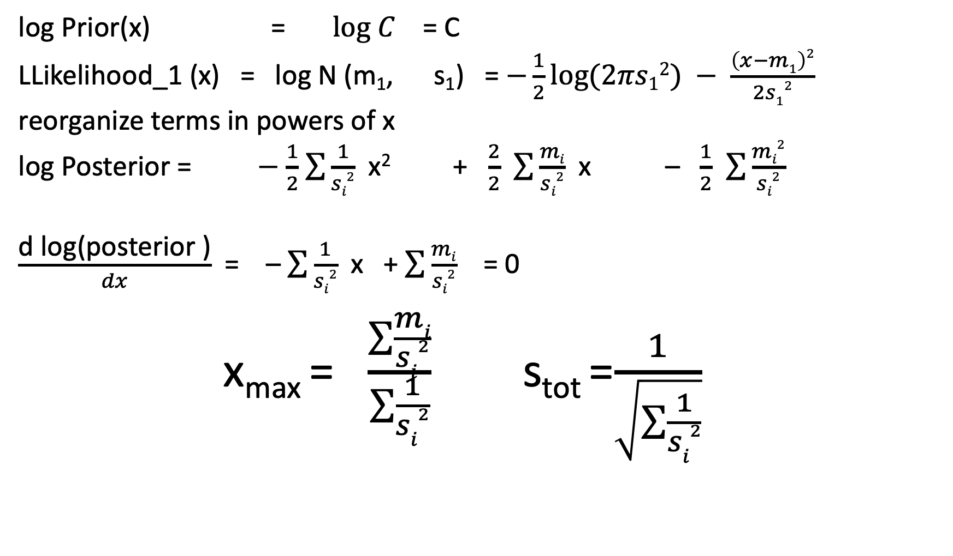
Least-squares adjustment
log Prior(x) = $log C$ = C
LLikelihood_1 (x) = log N (m₁, s₁) = $−\frac{1}{2}\log{(2πs12}) −$ $\frac{\left(x−m1\right)2}{2s12}$
reorganize terms in powers of x
log Posterior = $−$ $\frac{1}{2}$ $\sum{\frac{1}{si2}}$ x² + $\frac{2}{2}$ $\sum{\frac{mi}{si2}}$ x – $\frac{1}{2}$ $\sum{\frac{mi2}{si2}}$
$\frac{\text{d} \text{log}\text{(}\text{posterior}\text{ )}}{dx}$ = – $\sum{\frac{1}{si2}}$ x + $\sum{\frac{mi}{si2}}$ = 0
x_{max} = $\frac{\sum{\frac{mi}{si2}}}{\sum{\frac{1}{si2}}}$ s_{tot} =$\frac{1}{\sqrt{\sum{\frac{1}{si2}}}}$

Slide 16
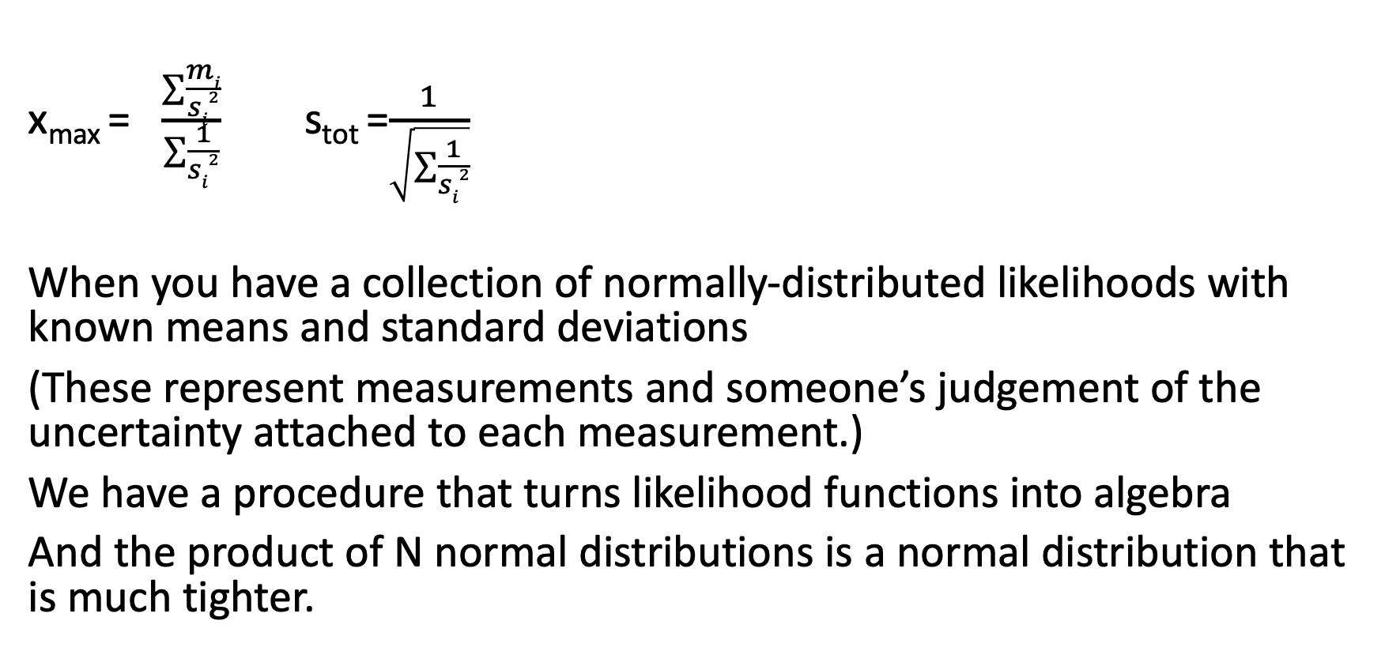
Ta-da! (Undergrad-level combination of measurements)
x_{max} = $\frac{\sum{\frac{mi}{si2}}}{\sum{\frac{1}{si2}}}$ s_{tot} =$\frac{1}{\sqrt{\sum{\frac{1}{si2}}}}$
When you have a collection of normally-distributed likelihoods with known means and standard deviations
(These represent measurements and someone’s judgement of the uncertainty attached to each measurement.)
We have a procedure that turns likelihood functions into algebra
And the product of N normal distributions is a normal distribution that is much tighter.

Slide 17
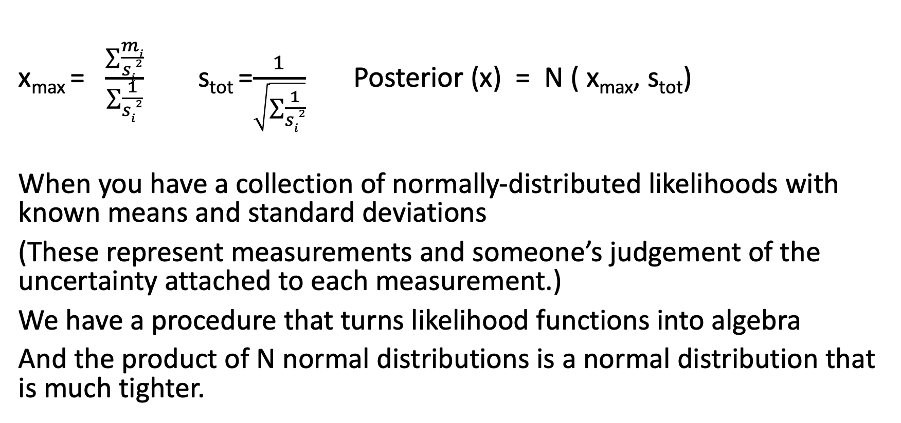
Ta-da! (Undergrad-level combination of measurements)
x_{max} = $\frac{\sum{\frac{mi}{si2}}}{\sum{\frac{1}{si2}}}$ s_{tot} =$\frac{1}{\sqrt{\sum{\frac{1}{si2}}}}$ Posterior (x) = N ( x_{max}, s_{tot})
When you have a collection of normally-distributed likelihoods with known means and standard deviations
(These represent measurements and someone’s judgement of the uncertainty attached to each measurement.)
We have a procedure that turns likelihood functions into algebra
And the product of N normal distributions is a normal distribution that is much tighter.
Caution: this procedure does not know or care whether the measurements agree with each other.

Slide 18
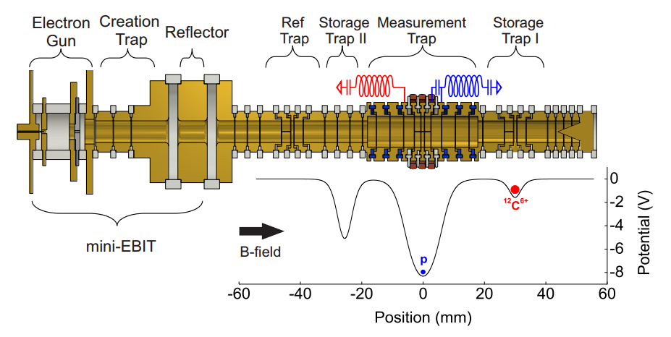
This is a balance that compares the mass of the proton to
the mass of ¹²C⁶⁺
F. Heiße et al. 2017. High-Precision Measurement of the Proton’s Atomic Mass. Phys. Rev. Lett 119 (3): 033001; doi: 10.1103/PhysRevLett.119.033001

Slide 19
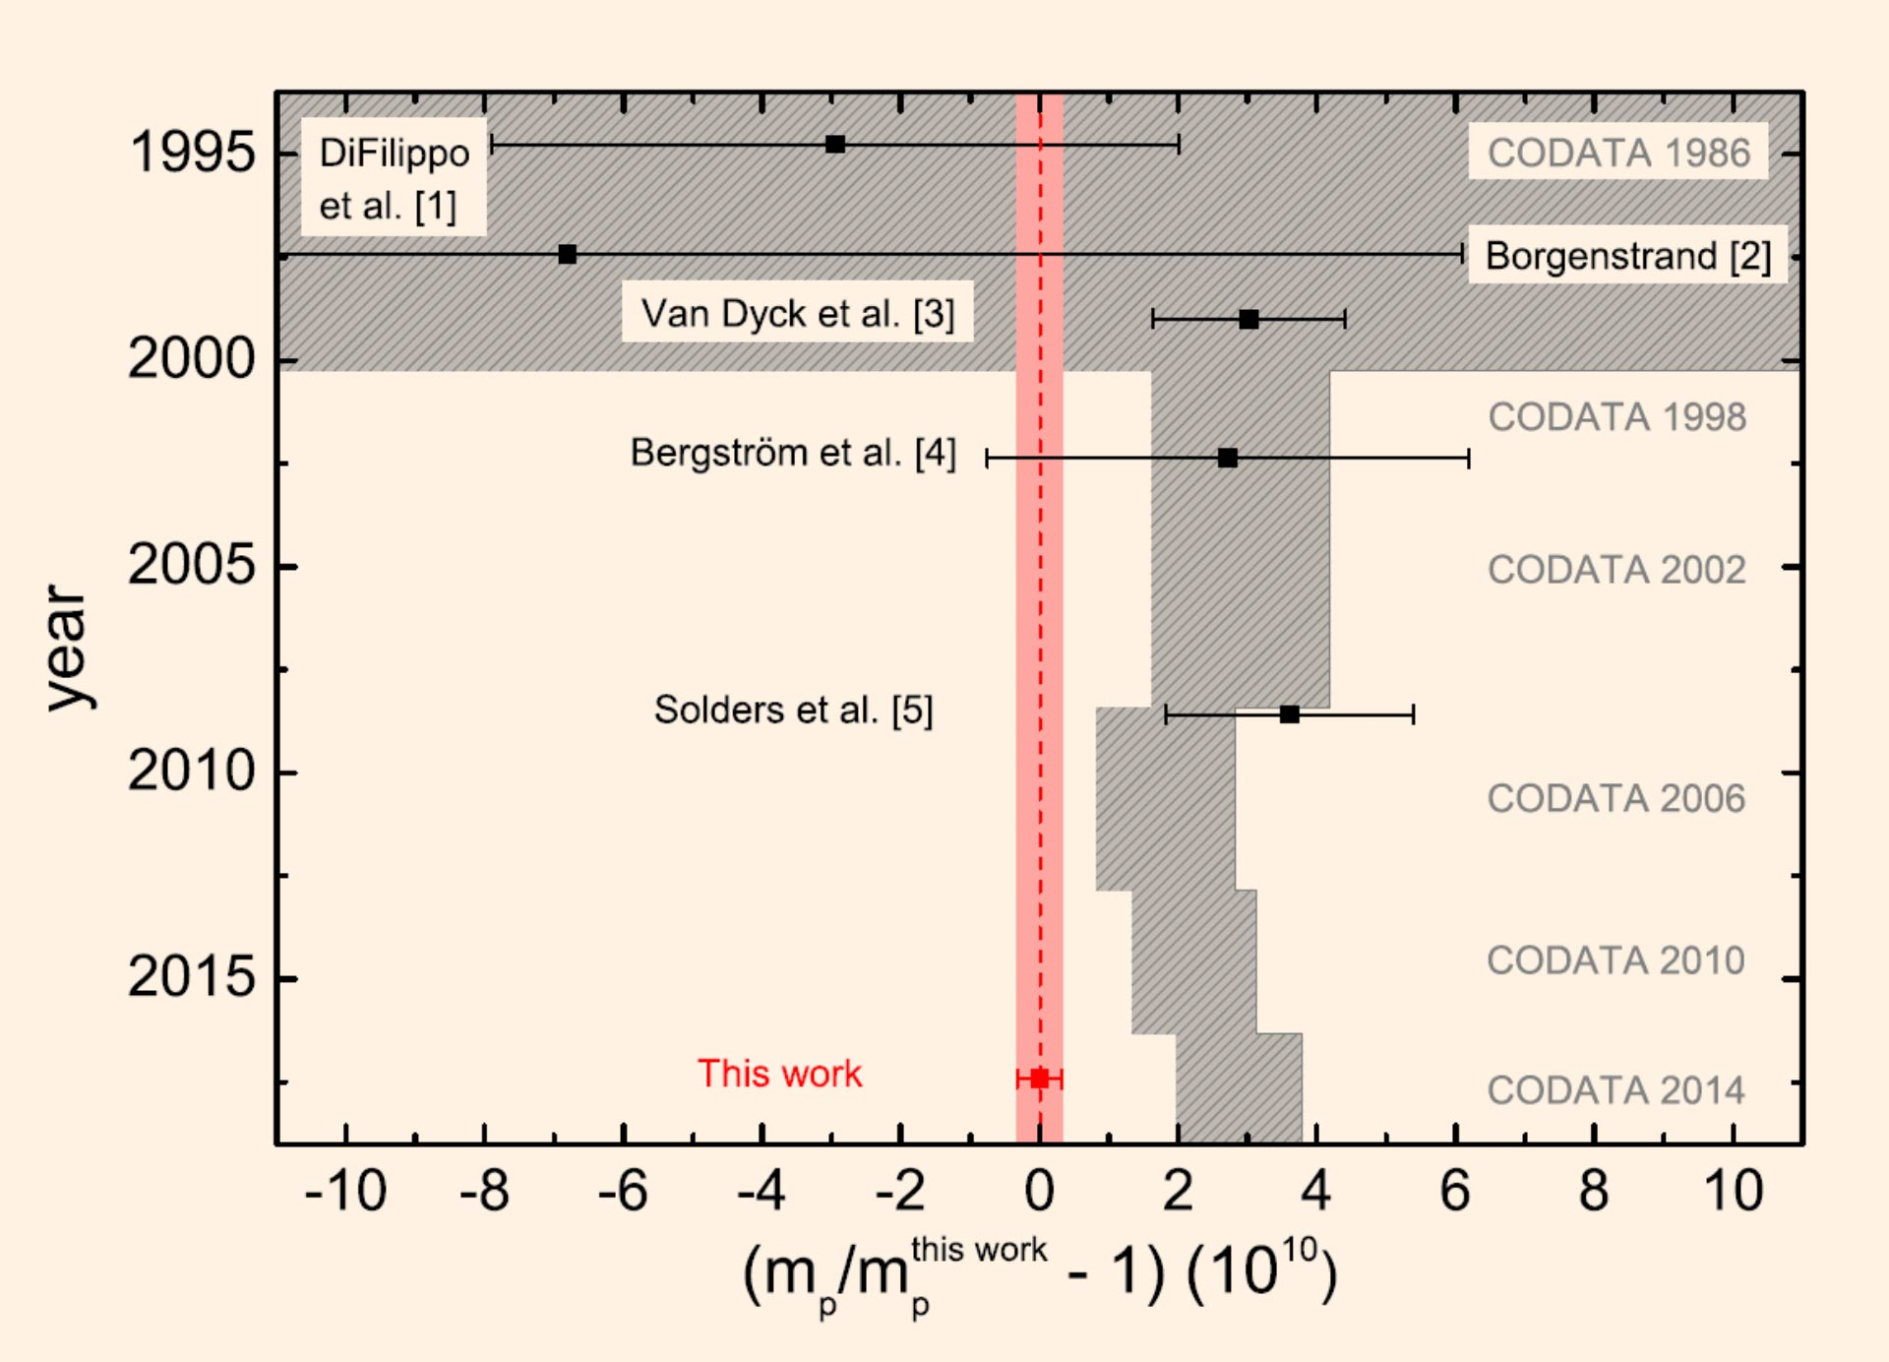
Multiple researchers, with advancing technology, have taken cracks at measuring the mass of the proton.
F. Heiße et al. 2017. High-Precision Measurement of the Proton’s Atomic Mass. Phys. Rev. Lett 119 (3): 033001; doi: 10.1103/PhysRevLett.119.033001

Slide 20
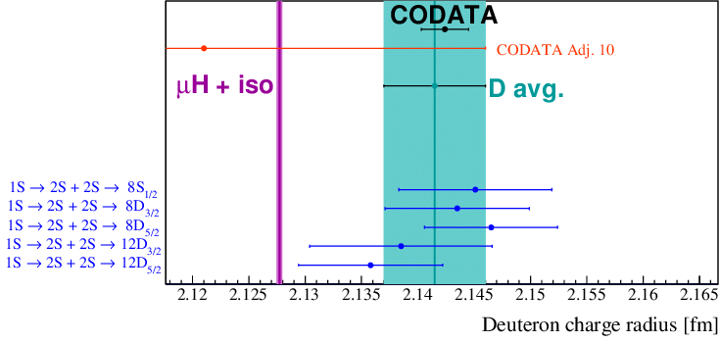
In a different measurement campaign, there are multiple (technically different) measurement approaches to the deuteron charge radius.

Slide 21
In a different measurement campaign, there are multiple (technically different) measurement approaches to the deuteron charge radius.
In a measurement-evaluation doctrine called “Least Squares Adjustment,” information about the physical constant (deuteron charge radius) is combined from multiple experiments using a very lightweight version of Bayesian inference.
Goes by the term “metaanalysis” in other fields.

Slide 22
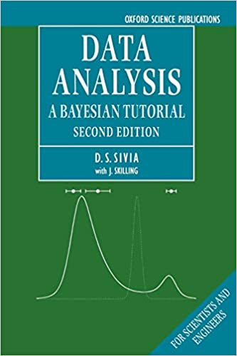
In a different measurement campaign, there are multiple (technically different) measurement approaches to the deuteron charge radius.
In a measurement-evaluation doctrine called “Least Squares Adjustment,” information about the physical constant (deuteron charge radius) is combined from multiple experiments using a very lightweight version of Bayesian inference.
Goes by the term “metaanaylsis” in other fields.

Slide 23
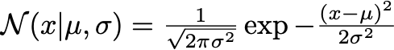
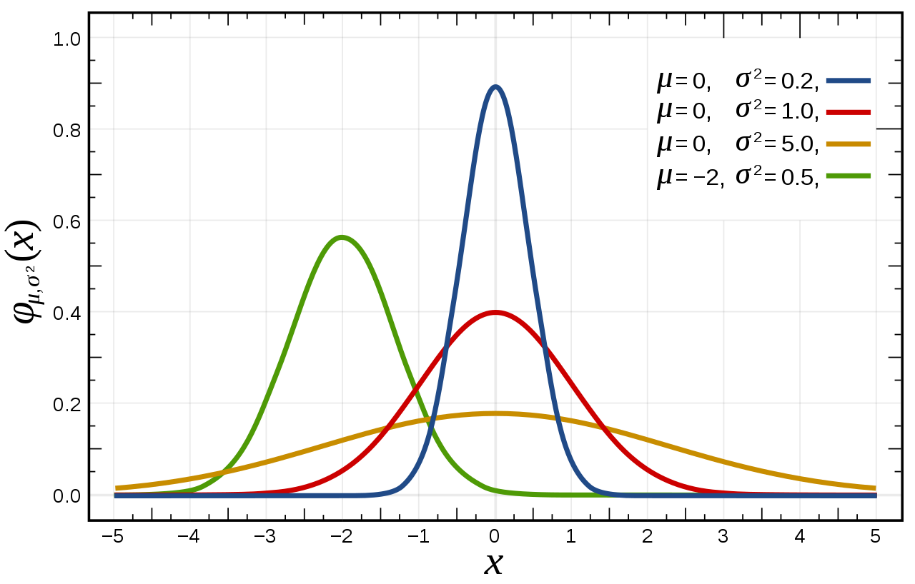
Anatomy of the normal distribution
“The normalizing constant”
peak density proportional to 1/σ
x- dependence
shape and position
of distribution

Slide 24
Anatomy of the normal distribution
Constant term, not going to give us trouble
Term depends only on σ
Term depends on σ and μ

Slide 25
Anatomy of the normal distribution
Constant term, not going to give us trouble
Term depends only on σ
Term depends on σ and μ
Penalizes distributions that are too spread out
Tells us where the center is

Slide 26
Anatomy of the normal distribution
When σ is too large, this term makes likelihood small
When σ is too small, this term penalizes the likelihood because the distribution will miss the data.

Slide 27
Normal(x₁) x Normal (x₂) ??
If I take the product of two 1-D normal distributions, I get a perfectly good probability distribution, but it isn’t quite flexible enough for my data-modeling needs.
This factorizes into the product of a term that depends only on x₁ and σ₁ and a term only in x₂ and σ_{2.}
This expression doesn’t permit me to make distributions where the probability density of x₁ depends on the value of x₂

Slide 28
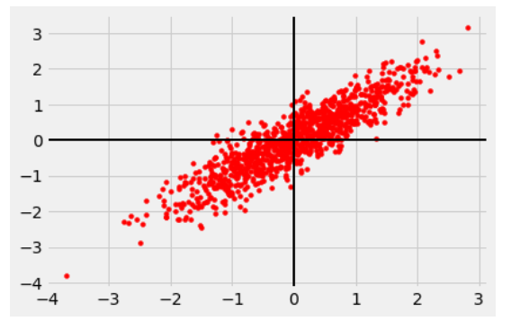
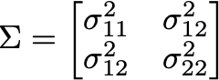
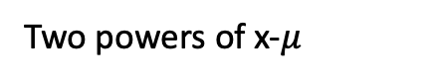
Multivariate normal
Constant term, not going to give us trouble
Two powers of x-$μ$
Term depends only on Σ

Slide 29
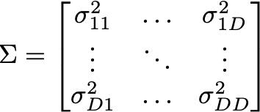
Multivariate normal

Slide 30
Multivariate normal
How many parameters do I need for a D-dimensional multivariate Gaussian ?

Slide 31
Multivariate normal
How many parameters do I need for a D-dimensional multivariate Gaussian ?
μ : D Σ : (D² + D )/2

Slide 32
Multivariate normal
Constant term, not going to give us trouble
Term depends only on Σ
Two powers of x-x₀
Σ covariance matrix
Σ⁻¹ “precision” matrix

Slide 33
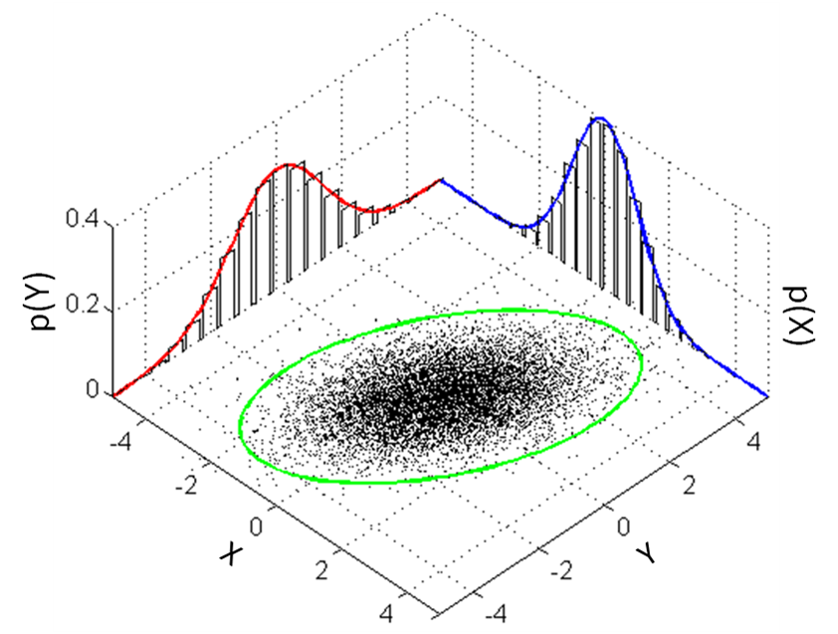
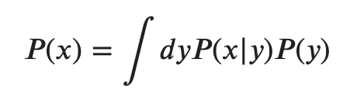
Jargon: Marginalization
To “marginalize” is to take a distribution of many variables and turn it into a distribution of fewer variables by integrating the product of the density and the prior probability of each of the unwanted variables.
When we are able to do this, this gives us the one-dimensional probability distribution (for the parameter of interest) that we seek, in essence averaging over all likely values of the variables not of interest.

Slide 34
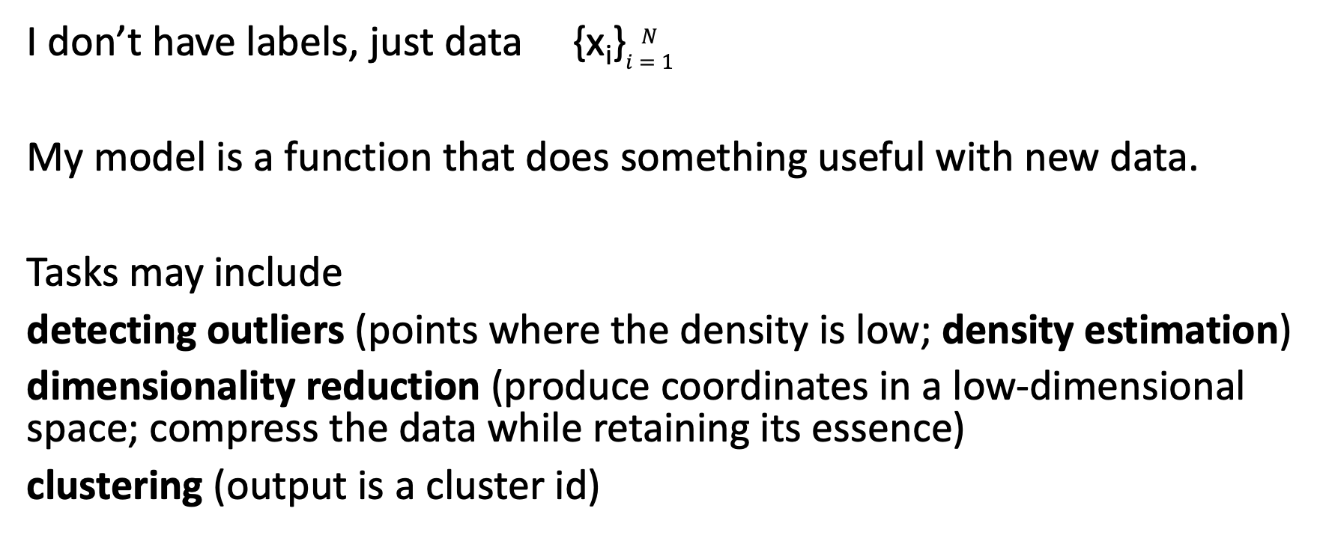
Unsupervised learning
I don’t have labels, just data {x_{i}}$\begin{matrix}N \\ i=1\end{matrix}$
My model is a function that does something useful with new data.
Tasks may include
detecting outliers (points where the density is low; density estimation)
dimensionality reduction (produce coordinates in a low-dimensional space; compress the data while retaining its essence)
clustering (output is a cluster id)

Slide 35
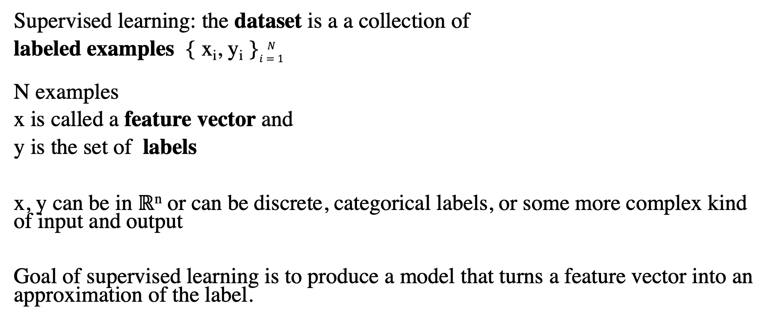
Supervised learning
Supervised learning: the dataset is a a collection of
labeled examples { x_{i}, y_{i} }$\begin{matrix}N \\ i=1\end{matrix}$
N examples
x is called a feature vector and
y is the set of labels
x, y can be in ℝ^{n} or can be discrete, categorical labels, or some more complex kind of input and output
Goal of supervised learning is to produce a model that turns a feature vector into an approximation of the label.

Slide 36
Reinforcement learning
Machine is allowed to interact with the “system”
Choices of the machine affect the information it receives; machine is allowed to explore the space of possible actions
Rewards for machine behavior that improves performance

Slide 37
Jargon
parameter = numbers that determine “the model.”
hyperparameter = number that controls the behavior of the learning algorithm
regression = prediction of a real-valued label
fitting = determining the parameters of the model
classification = prediction of a label from a finite set of labels
shallow learning algorithm – fits the parameters of the model from the features of the training data.
deep learning algorithm fits the parameters of the model from the output of layers that are fed by the training features.

Slide 38
Generative vs. discriminative
If I fit a probability distribution to my data, I can evaluate
P(newdata | model) and
P ( label | model, newdata)
but I also can draw samples from the distribution. Models of this sort are called “generative” models because they permit me to “generate” new data consistent with the model parameters.
Models that just find the function of x that gives the right answer y (say, by fitting weights directly rather than finding weights from fitted distribution parameters) are called “discriminative” models.

